Slide 1
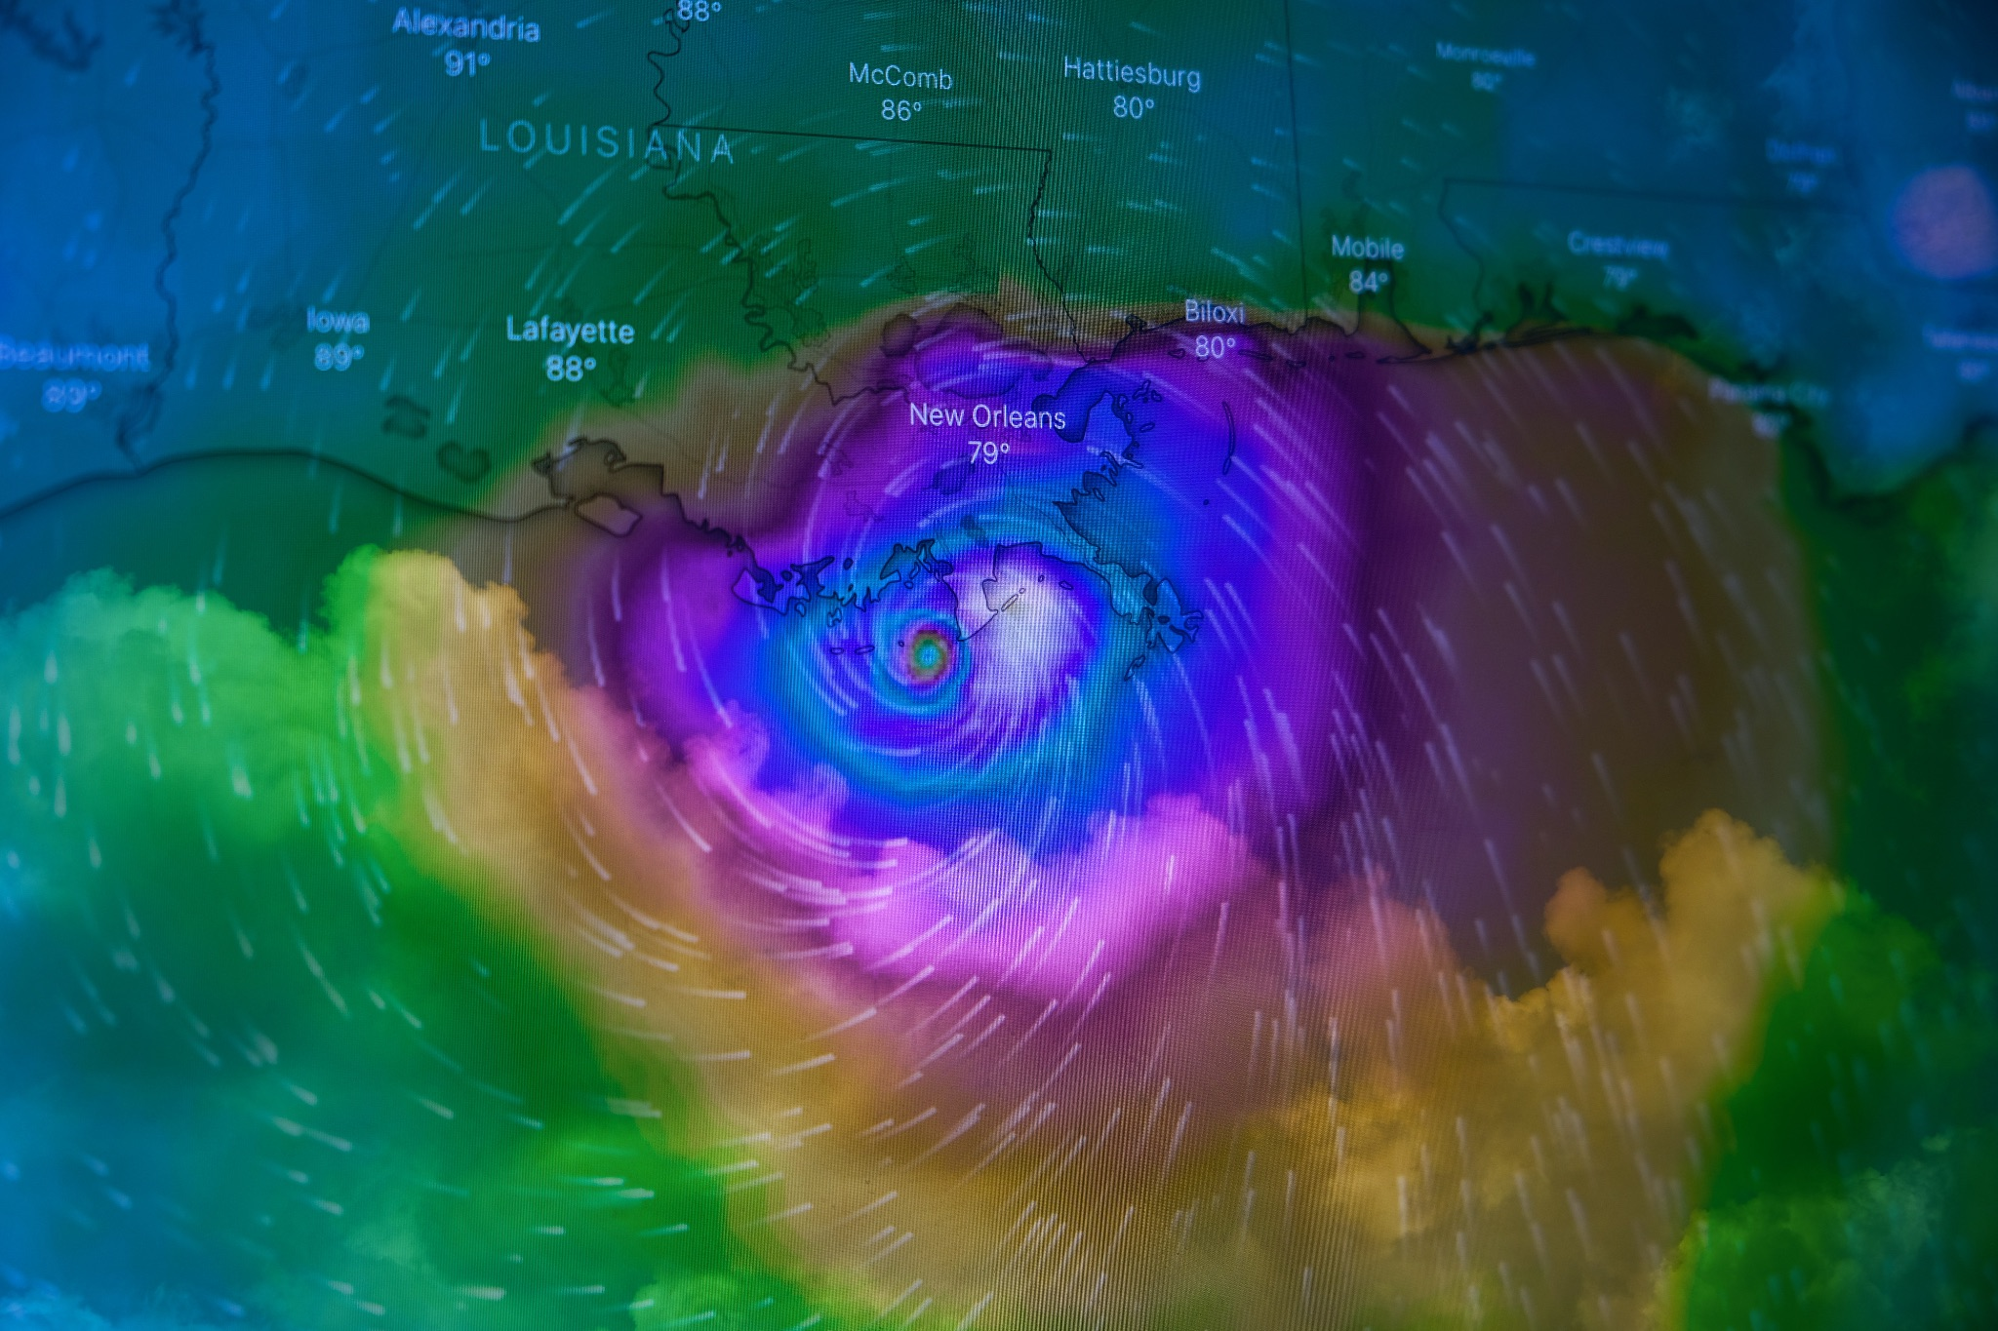

Natural Disasters
1900 - 2021
Team 7

Slide 2




Team 7
Erik Huerta
Pedro Arriola
Karen Bolaños
Brian Oliva

Slide 3
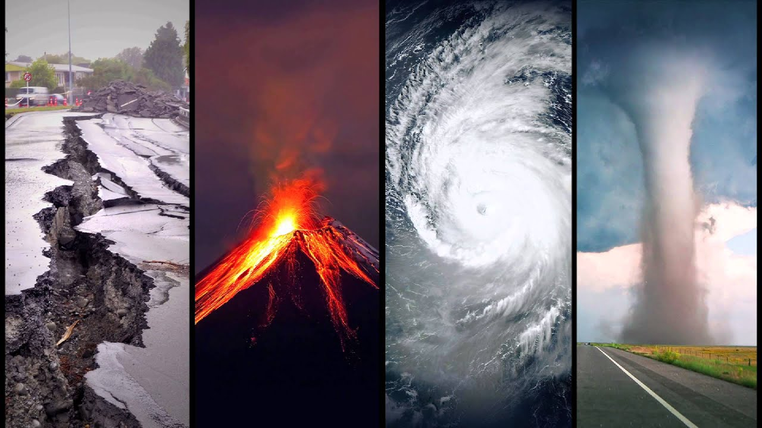
Introduction
Topic: interest in the current Climate Change situation
Our database is from: www.kaggle.com
The first glance at the database:
Plenty of data to work with from a long time-span (1900 - 2021)
From describe: we got 18 int/float variables and 27 objects

Slide 4
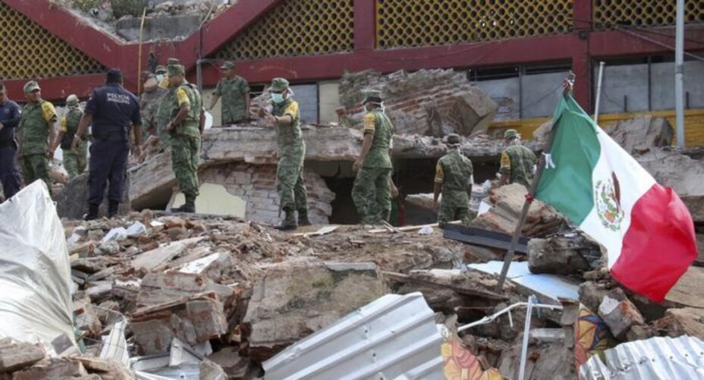
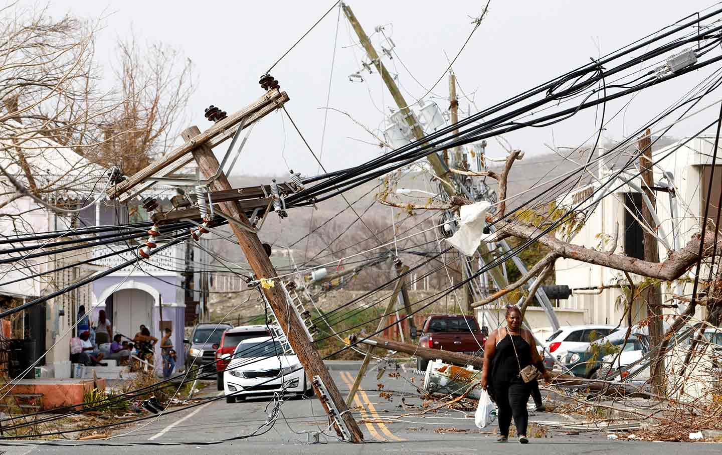
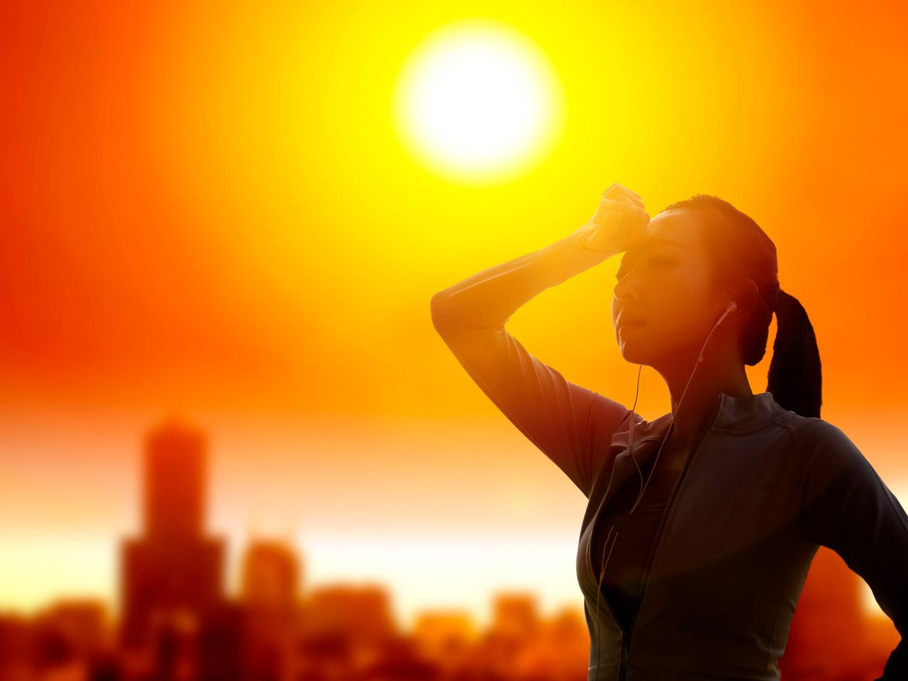
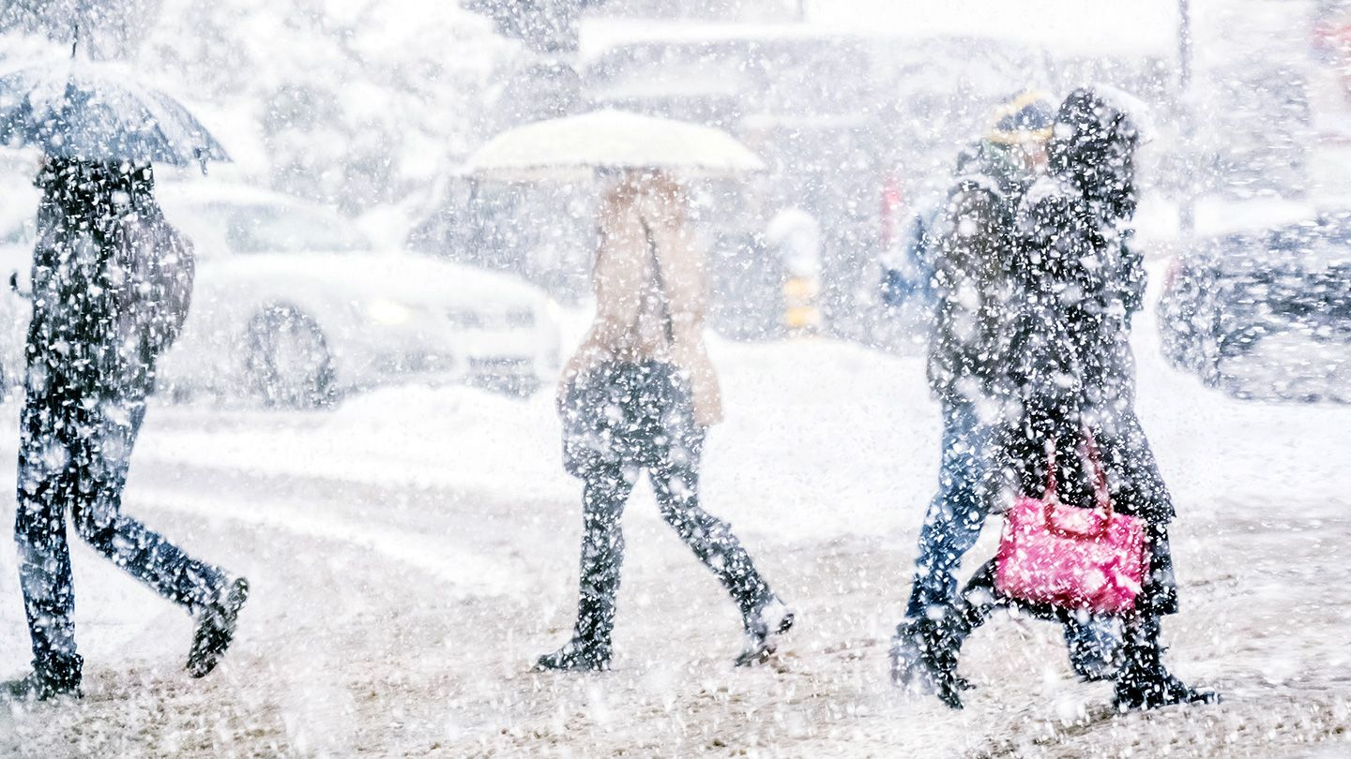
Are Natural Disasters increasing or decreasing over time? And, which ones are the most common?

Slide 5
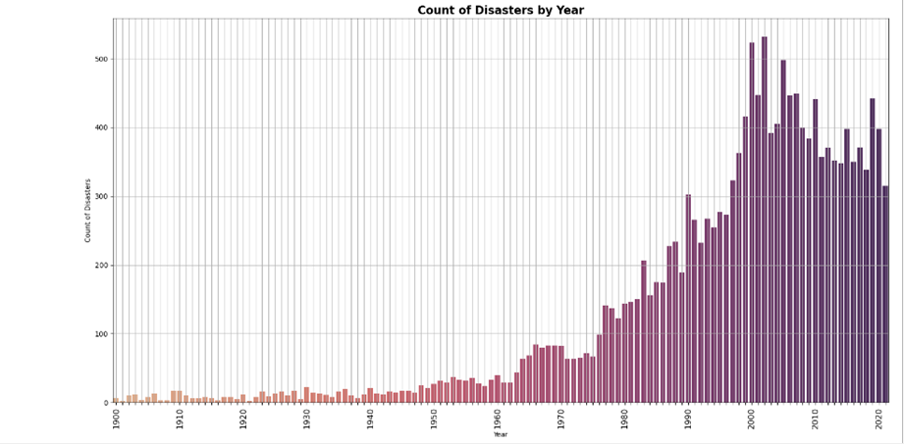
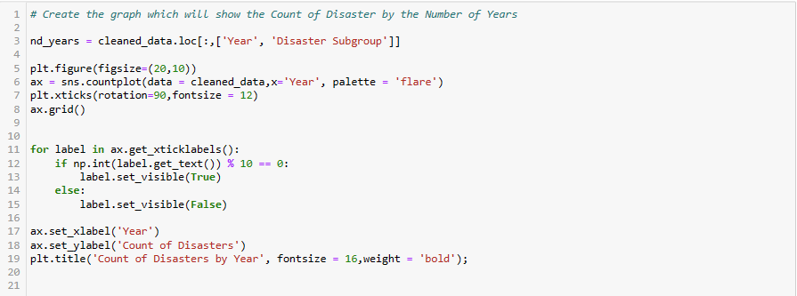
From the graph, as time goes on, natural disasters do increase.
Earlier years, less disasters. Later years, more disasters. But why?
Advances in Technology and quality data could be attributed to more data collection.
Global Warming?

Slide 6
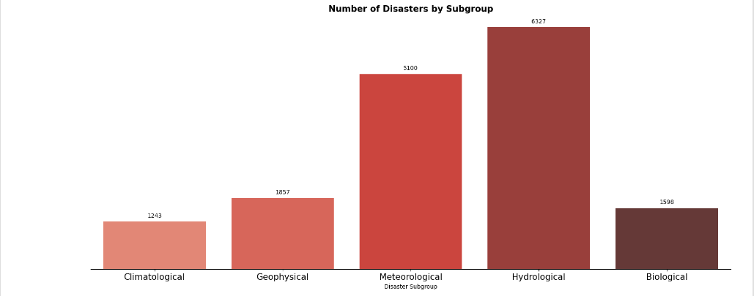
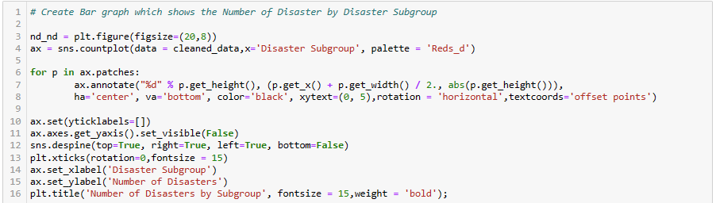

Slide 7
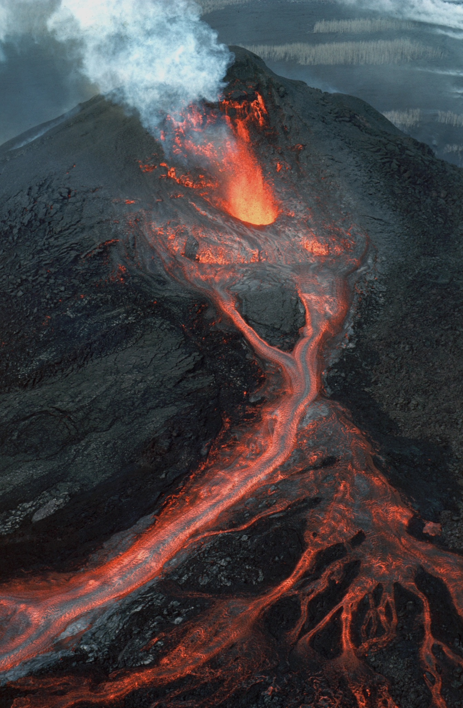

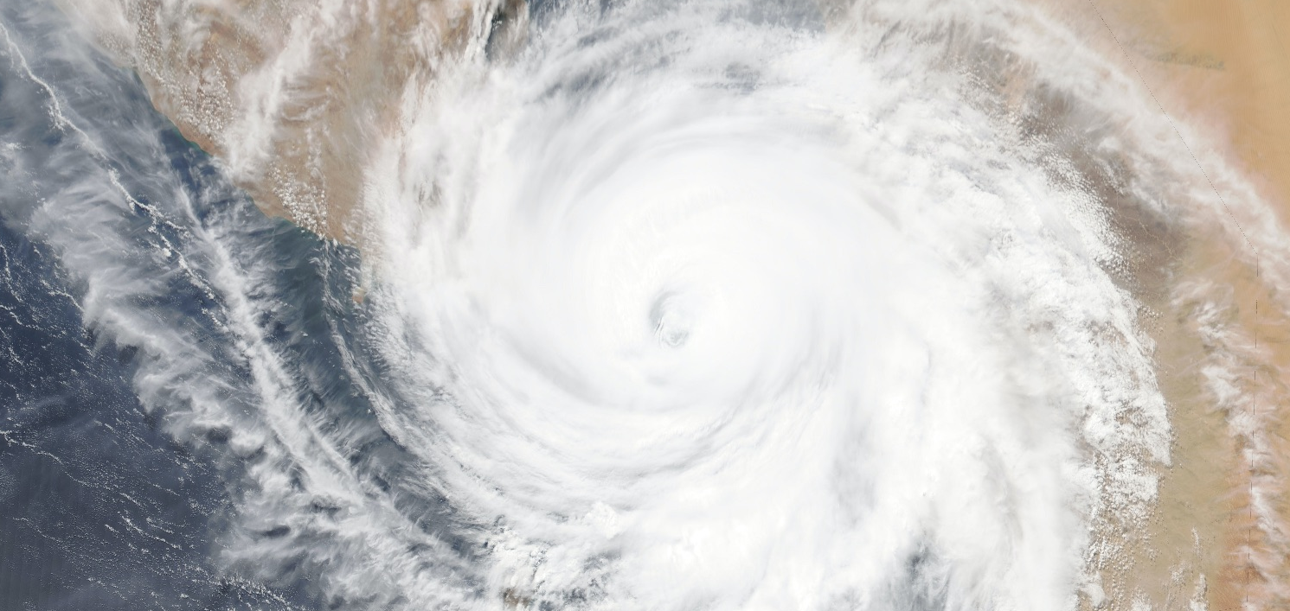
How do different disasters occur in different world regions recently?

Slide 8
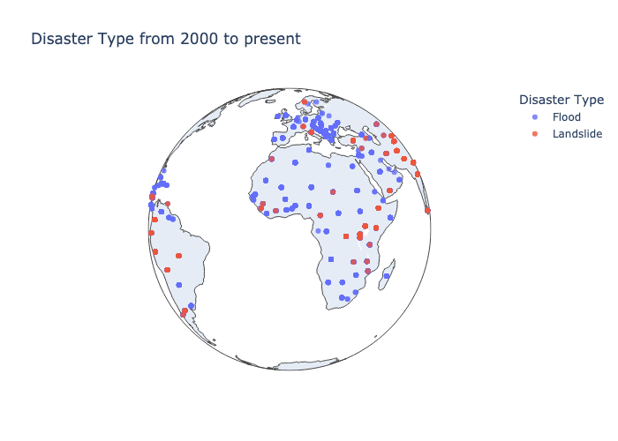
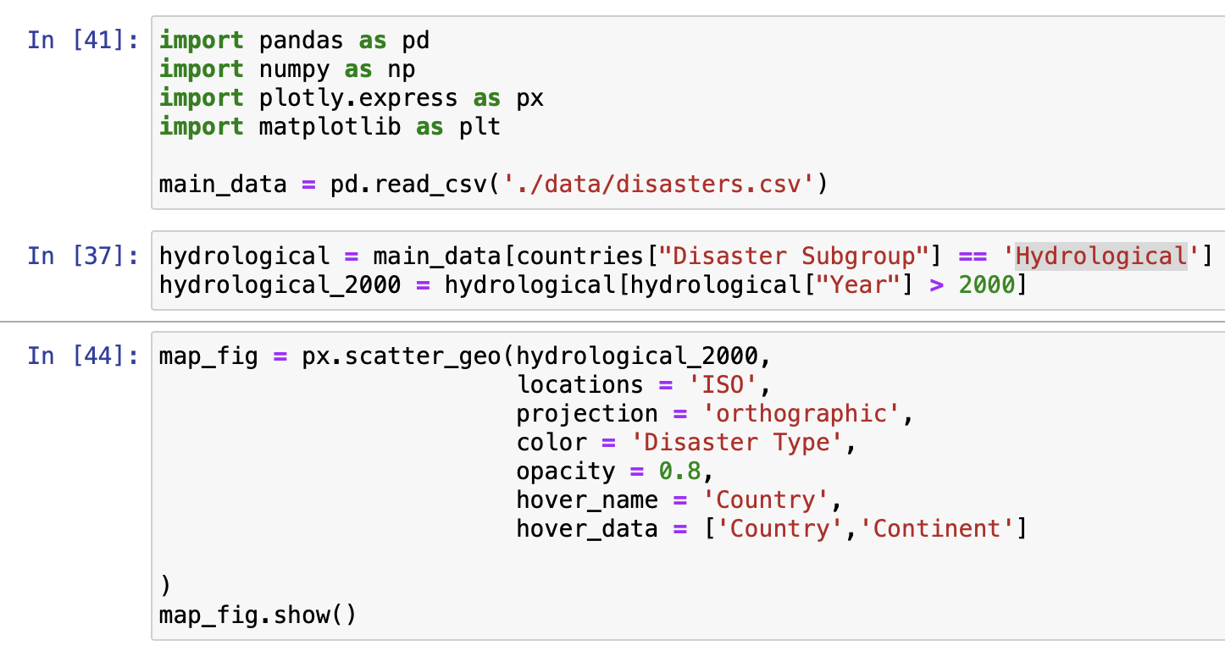
The most common Hydrological disaster (between Flood and Landslide) is flood

Slide 9
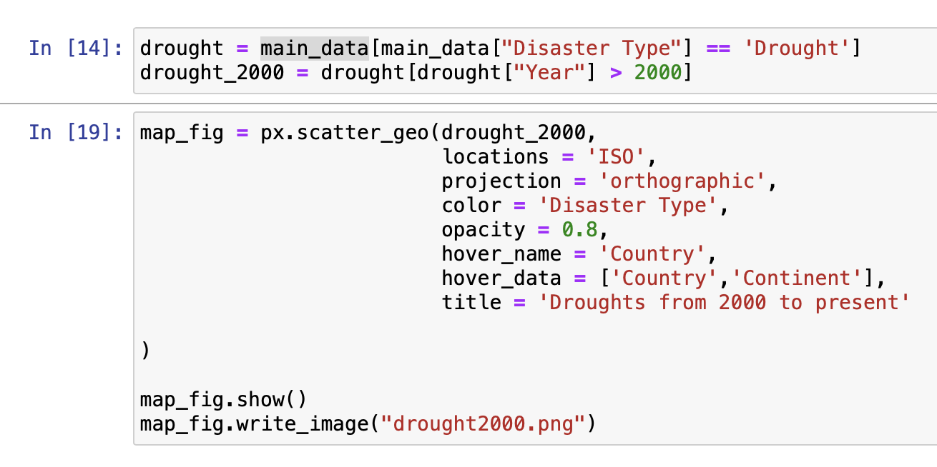
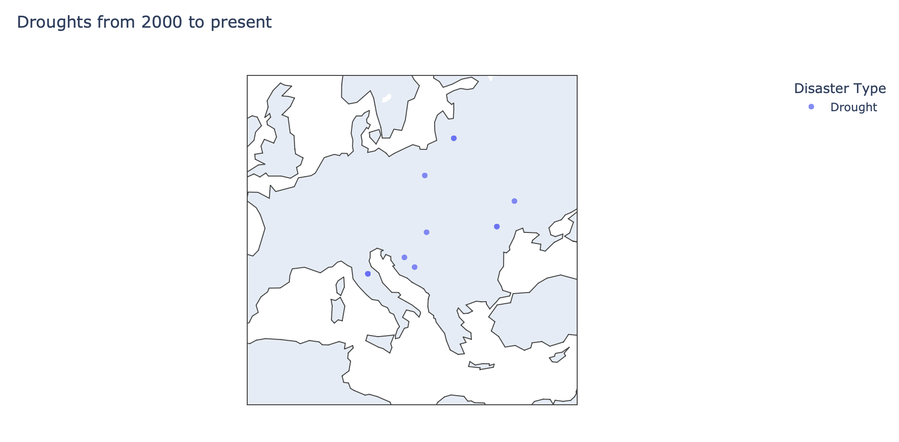
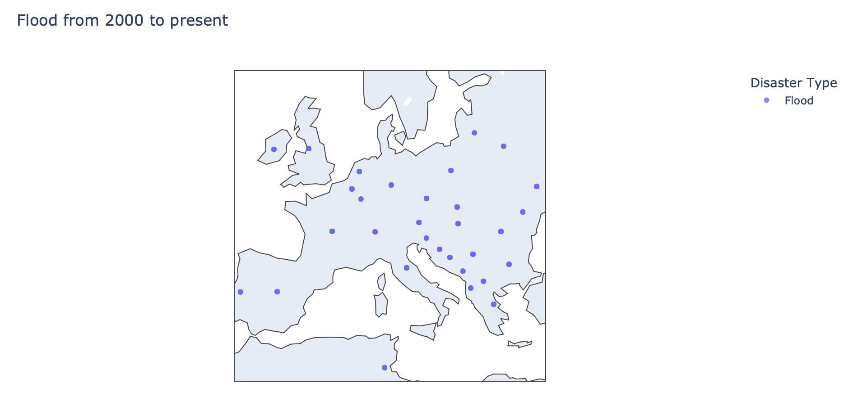
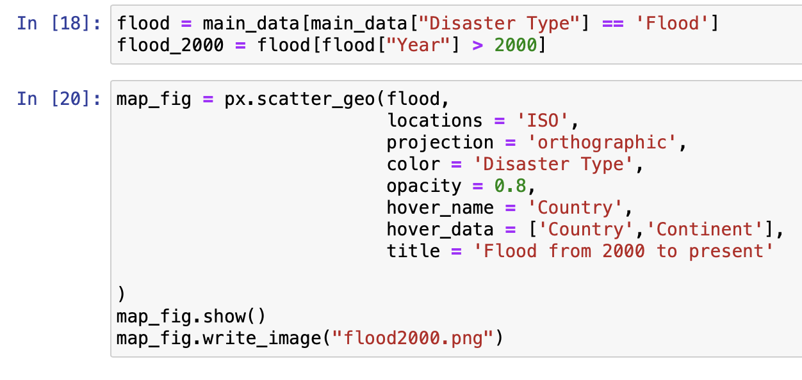
The occurrences of floods in the region of Europe have surpassed the occurrences of droughts in recent years.

Slide 10

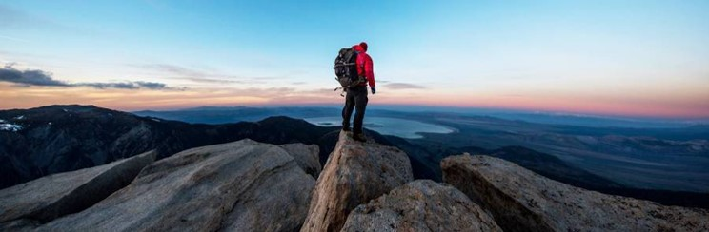
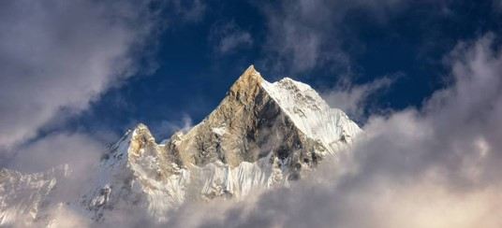
Is there a correlation between all the data?

Slide 11
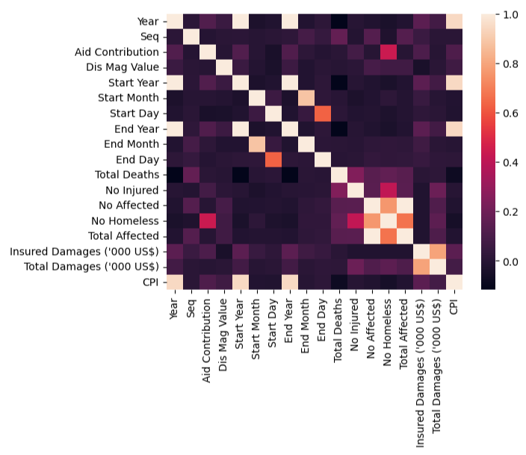
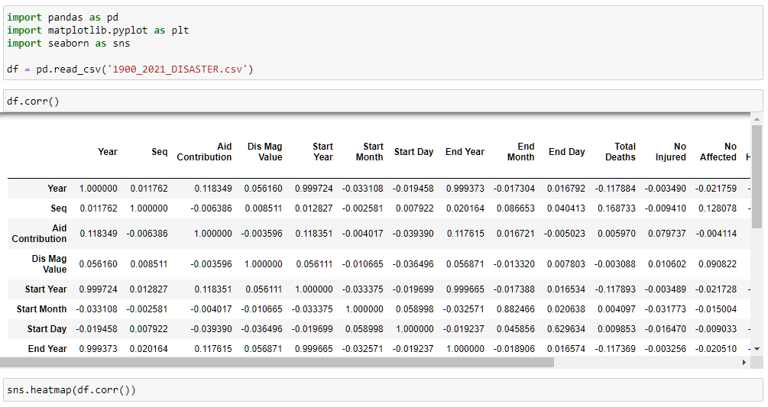
Is there a correlation
in the database?
There is not correlation in the DataBase

Slide 12
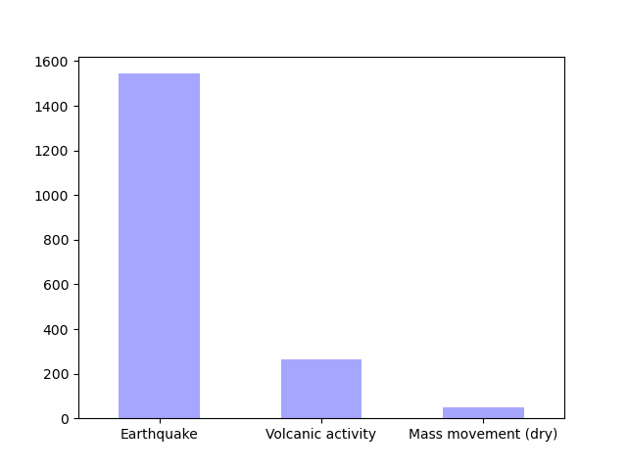
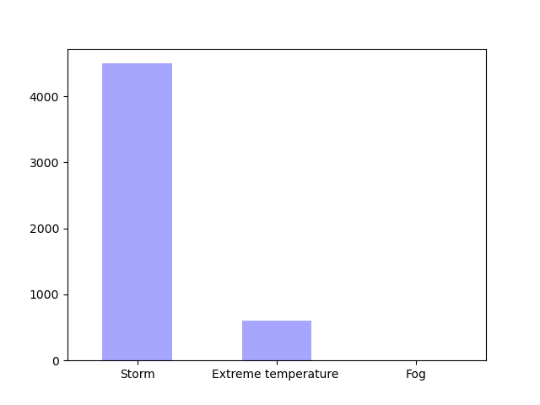
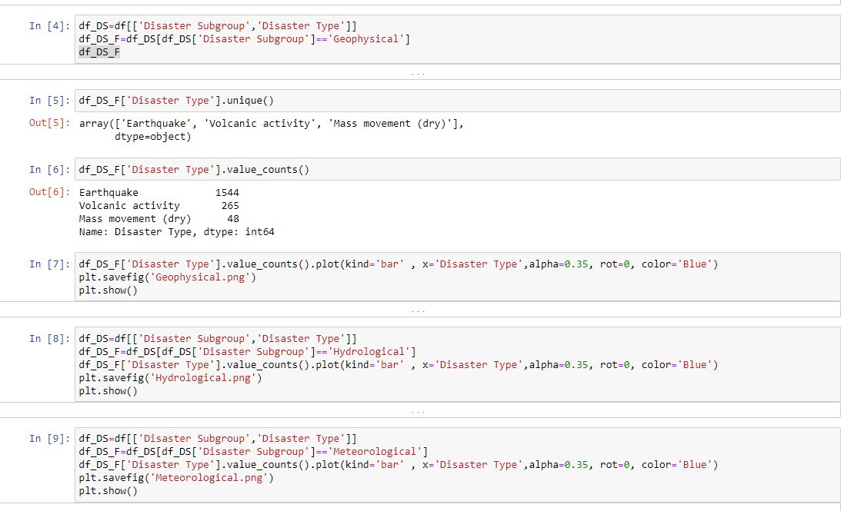
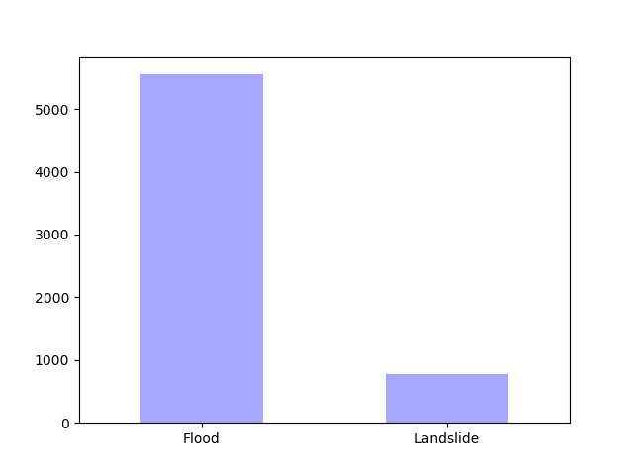
The most common disasters:
Geophysical
Hydrological
Meteorological

Slide 13
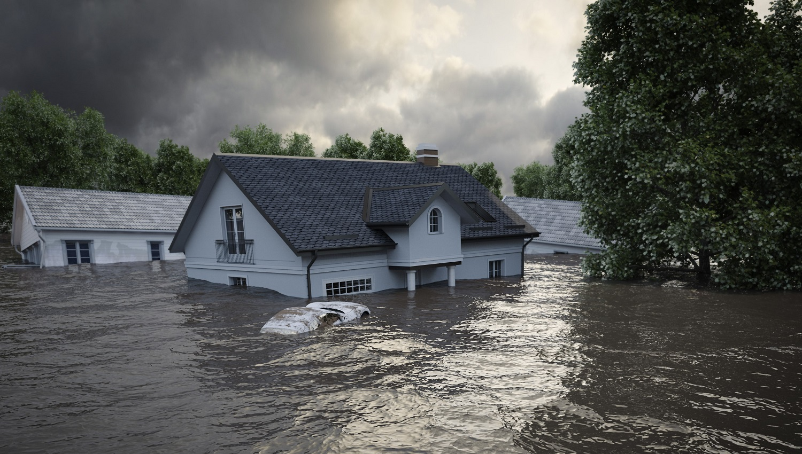
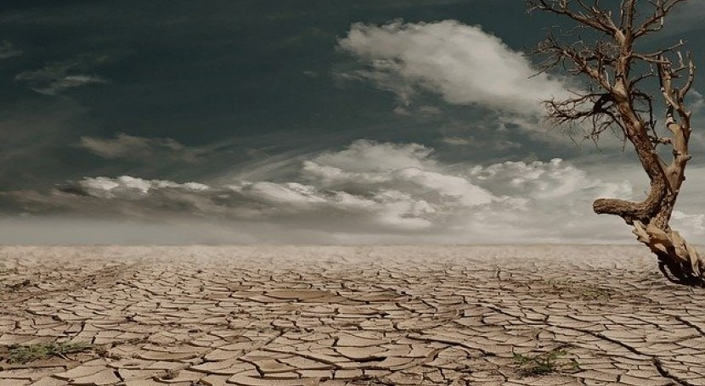
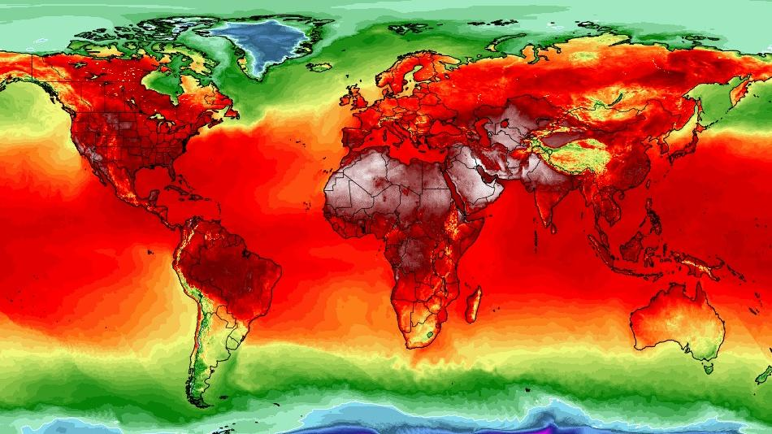
What happened to the number of deaths and number of disasters over the years? How can we explain it?

Slide 14
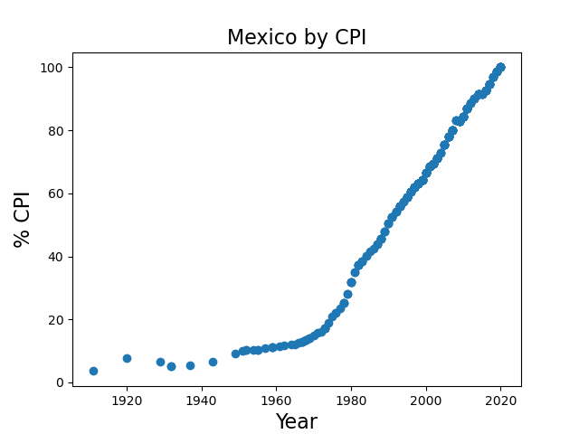
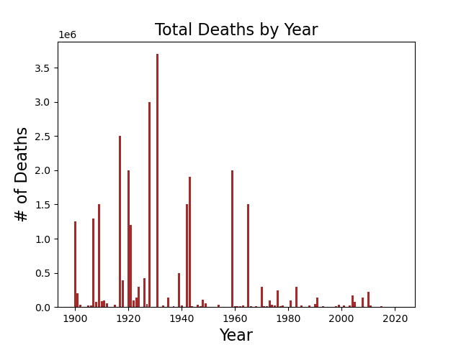
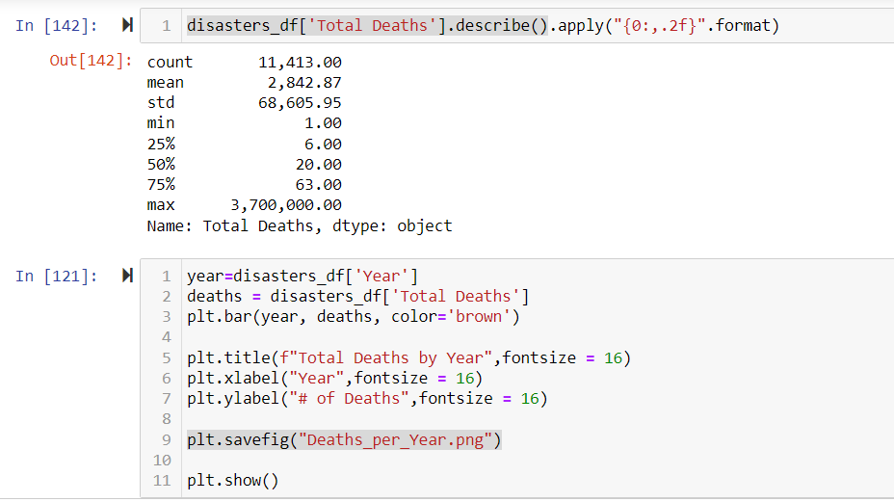
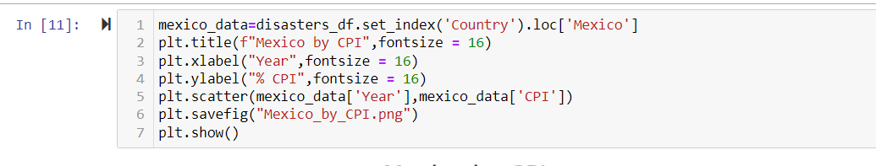
Why the Decrease?
Technology
Community Preparedness
count 11,413.00
mean 2,842.87
std 68,605.95
min 1.00
25% 6.00
50% 20.00
75% 63.00
max 3,700,000.00

Slide 15
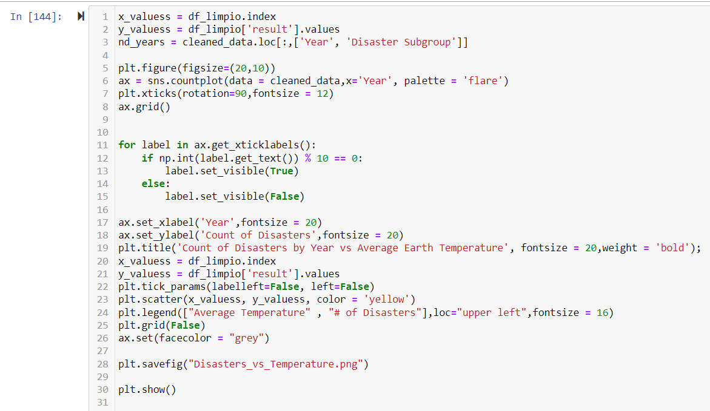
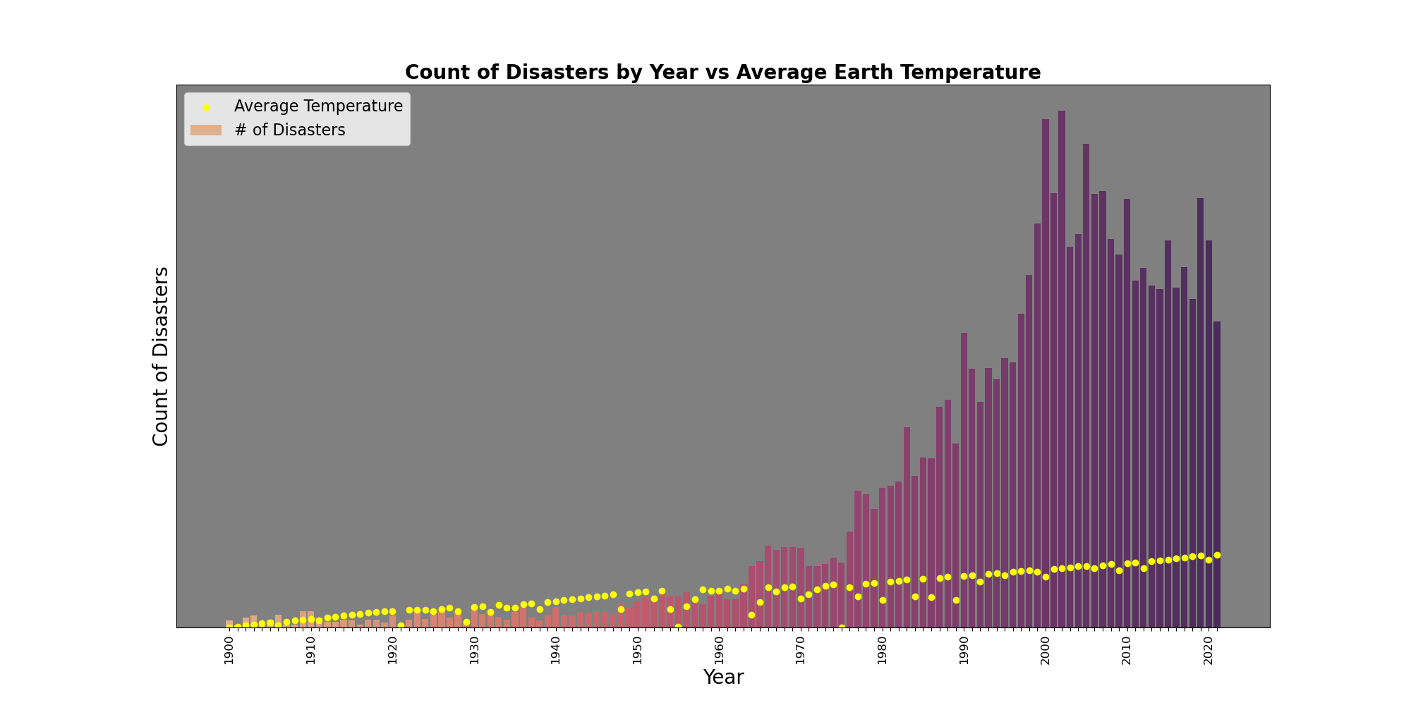
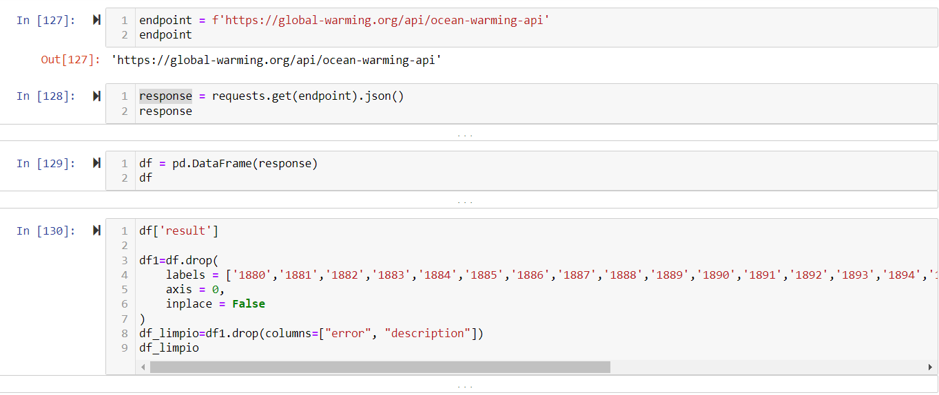
Why the Increase?
Global Warming
Earth and Ocean Temperature
Bonus! API

Slide 16
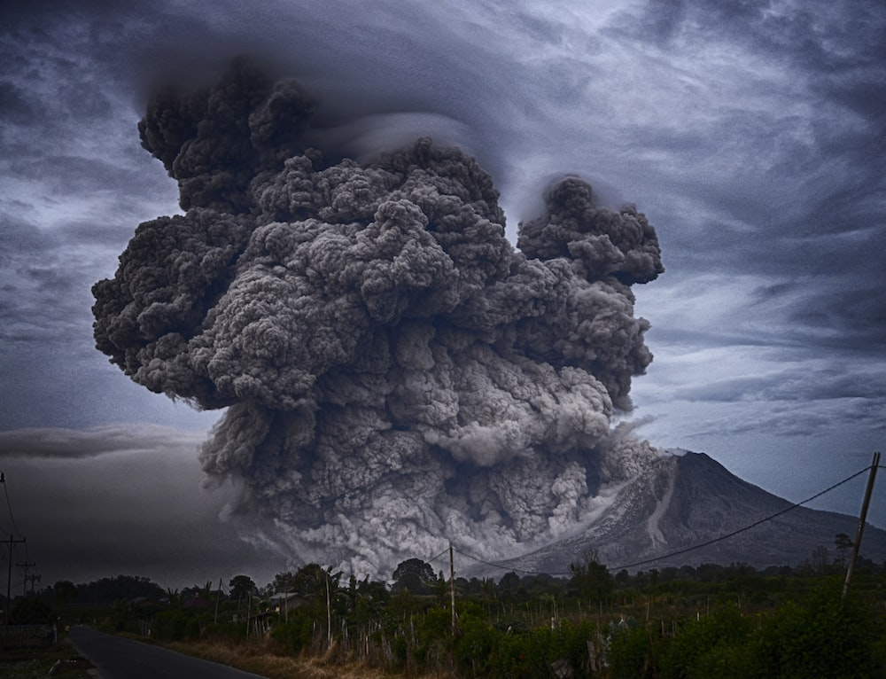
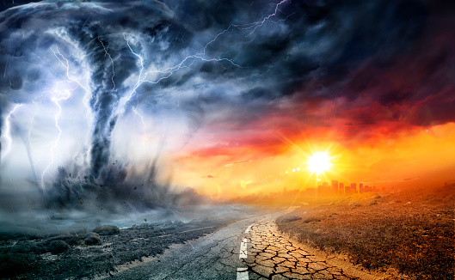
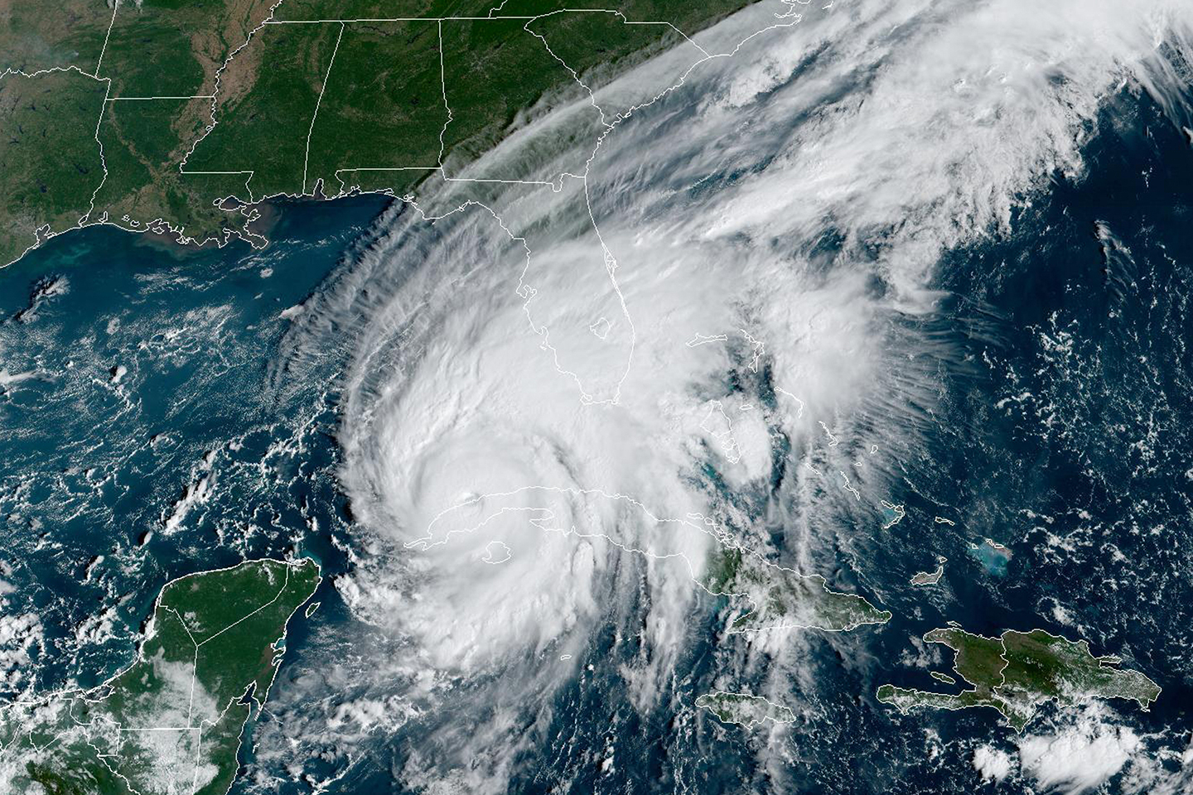
Thank you!
Questions?

